Slide 1
Contiguous Memory Allocation

Slide 2
Memory protection
Relocation registers used to protect user processes from each other, and from changing operating-system code and data
Base register contains value of smallest physical address
Limit register contains range of logical addresses – each logical address must be less than the limit register
MMU maps logical address dynamically
Can then allow actions such as kernel code being transient – comes and goes as needed. Thus, kernel can change size dynamically.

Slide 3
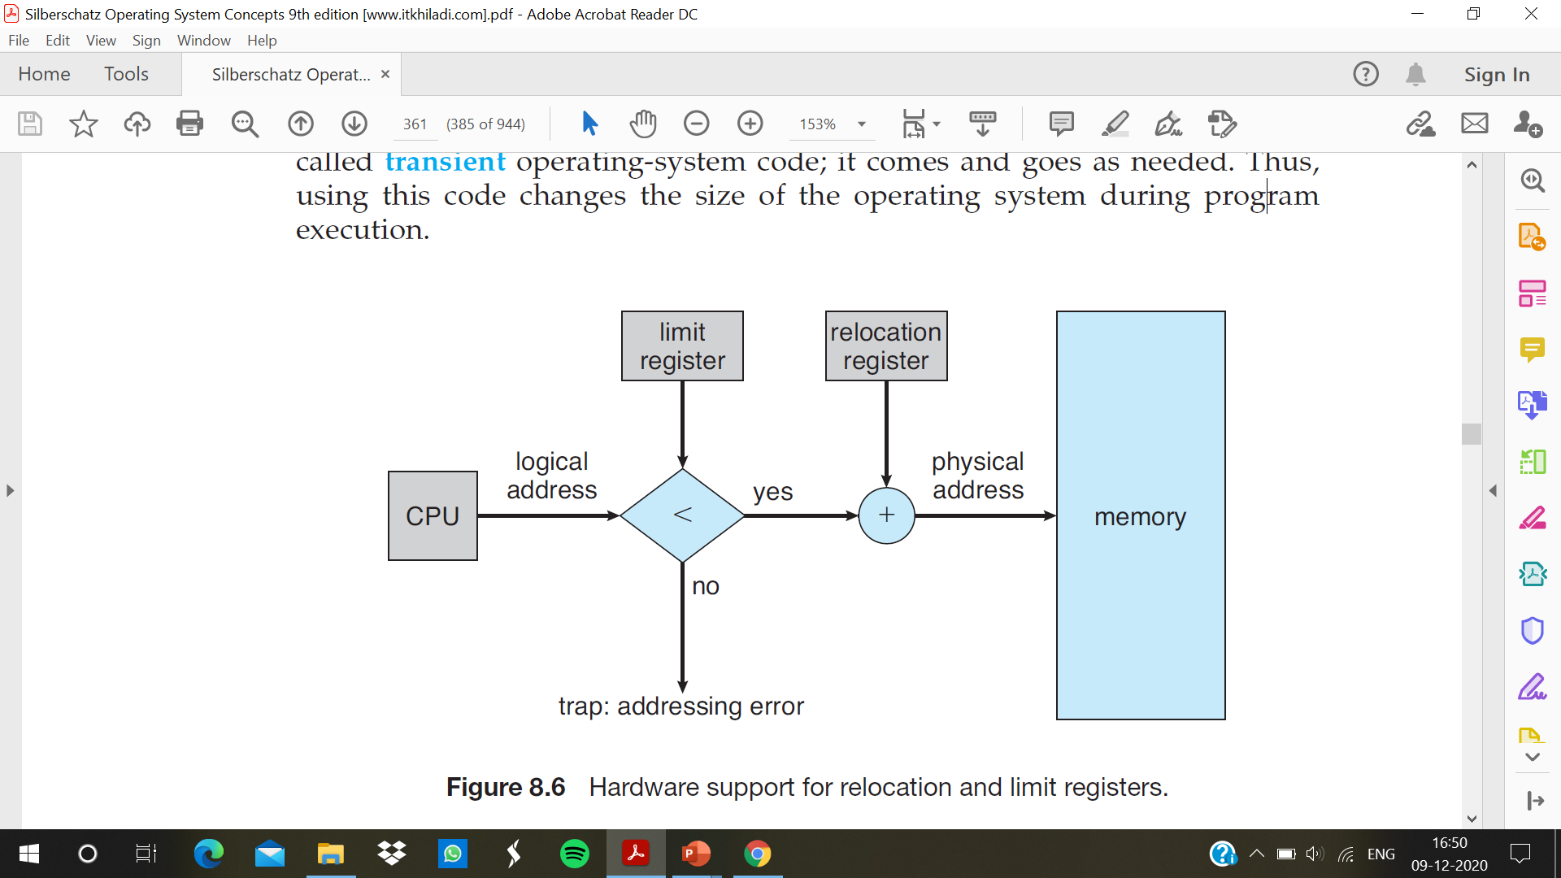

Slide 4
Memory allocation
The main memory must accommodate both the operating system and the various user processes. The memory is usually divided into two partitions: one for the resident operating system and one for the user processes.
In Contiguous memory allocation, when the process arrives from the ready queue to the main memory for execution, the contiguous memory blocks are allocated to the process according to its requirement. Now, to allocate the contiguous space to user processes, the memory can be divide either in the fixed-sized partition or in the variable-sized partition.
Fixed-Sized Partition: In the fixed-sized partition, the memory is divided into fixed-sized blocks and each block contains exactly one process. But, the fixed-sized partition will limit the degree of multiprogramming as the number of the partition will decide the number of processes.
Variable-Size Partition: In the variable size partition method, the operating system maintains a table that contains the information about all memory parts that are occupied by the processes and all memory parts that are still available for the processes.

Slide 5
How holes are created in the memory?
Initially, the whole memory space is available for the user processes as a large block, a hole. Eventually, when the processes arrive in the memory, executes, terminates and leaves the memory.
In the variable size partition method, the operating system analyses the memory requirement of the process and see whether it has a memory block of the required size. If it finds the match, then it allocates that memory block to the process. If not, then it searches the ready queue for the process that has a smaller memory requirement.
The operating system allocates the memory to the process until it cannot satisfy the memory requirement of the next process in the ready queue. It stops allocating memory to the process if it does not have a memory block (hole) that is large enough to hold that process.
If the memory block (hole) is too large for the process it gets spilt into two parts. One part of the memory block is allocated to the arrived process and the other part is returned to the set of holes. When a process terminates and releases the memory allocated to it, the released memory is then placed back to the set of holes. The two holes that are adjacent to each other, in the set of holes, are merged to form one large hole.
Now, at this point, the operating system checks whether this newly formed free large hole is able to satisfy the memory requirement of any process waiting in the ready queue. And the process goes on.

Slide 6
strategies are the ones most commonly used to select a free hole from the set of available holes:
• First fit. Allocate the first hole that is big enough. Searching can start either at the beginning of the set of holes or at the location where the previous first-fit search ended . We can stop searching as soon as we find a free hole that is large enough.
• Best fit. Allocate the smallest hole that is big enough. We must search the entire list, unless the list is ordered by size. This strategy produces the smallest leftover hole.
• Worst fit. Allocate the largest hole. Again, we must search the entire list, unless it is sorted by size. This strategy produces the largest leftover hole, which may be more useful than the smaller leftover hole from a best-fit approach.

Slide 7
Fragmentation
Fragmentation can either be external fragmentation or internal fragmentation.
External fragmentation is when the free memory blocks available in memory are too small and even non-contiguous.
First fit analysis reveals that given N allocated blocks, another 0.5 N blocks will be lost to fragmentation
1/3 of memory may be unusable -> 50-percent rule
Internal fragmentation occurs when the process does not fully utilize the memory allocated to it.
The solution to the problem of external fragmentation is memory compaction. The goal is to shuffle the memory contents so as to place all free memory together in one large block
Another solution to the problem of external fragmentation : segmentation and paging

